Slide 1
Digital Marketing Campaign Conversion Prediction

Slide 2
Agenda
Project Overview
Exploratory data analysis (EDA)
Data Preprocessing
Feature Engineering
Model Selection
Model Evaluation
PowerBI

Slide 3
Project Overview
This project aims to enhance campaign effectiveness in the digital marketing sector by accurately predicting customer conversions.
By leveraging machine learning, the project seeks to identify potential converters and optimize marketing strategies.
The objective is to develop a robust machine learning model that predicts customer conversions based on various demographic and engagement factors, enabling improved campaign targeting, increased conversion rates, and maximized return on advertising spend (ROAS).

Slide 4
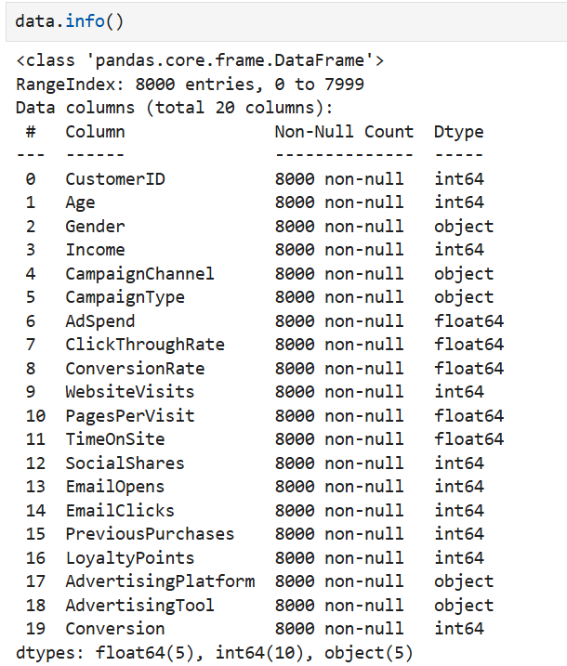
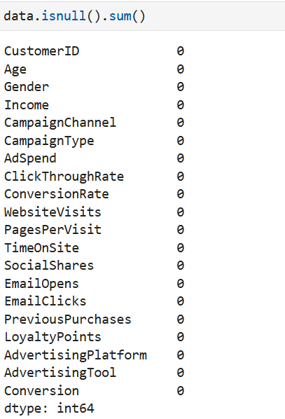
Exploratory data analysis (EDA)
In this process we check the info of our data.
In this process we check the null values of our data.

Slide 5
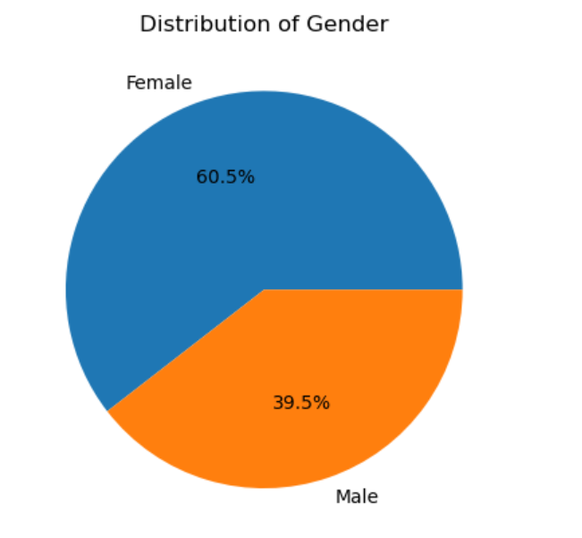
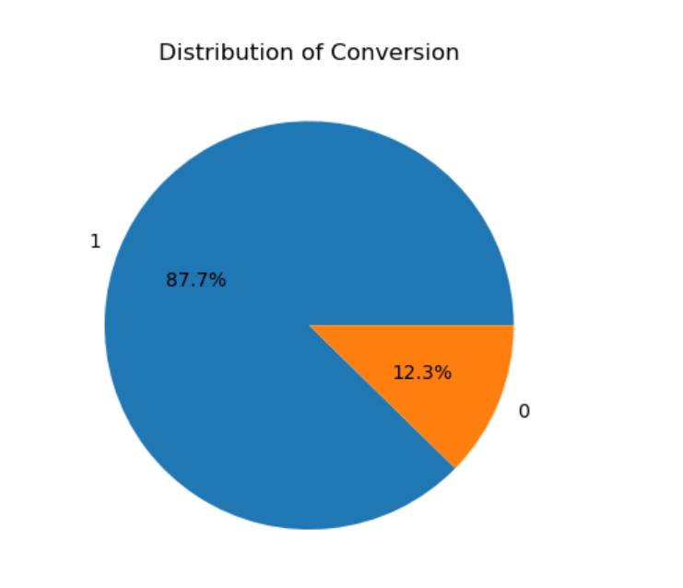
Exploratory data analysis (EDA)

Slide 6
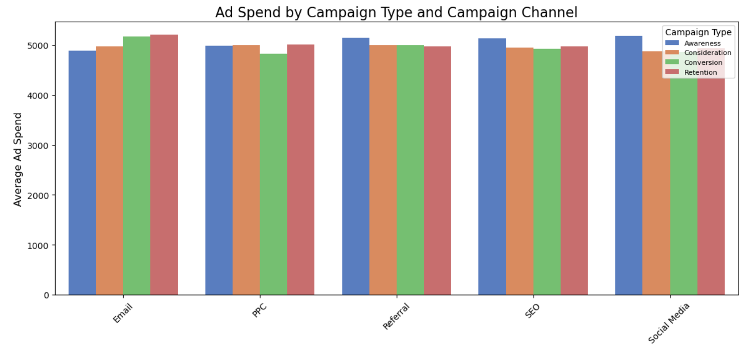
Exploratory data analysis (EDA)

Slide 7
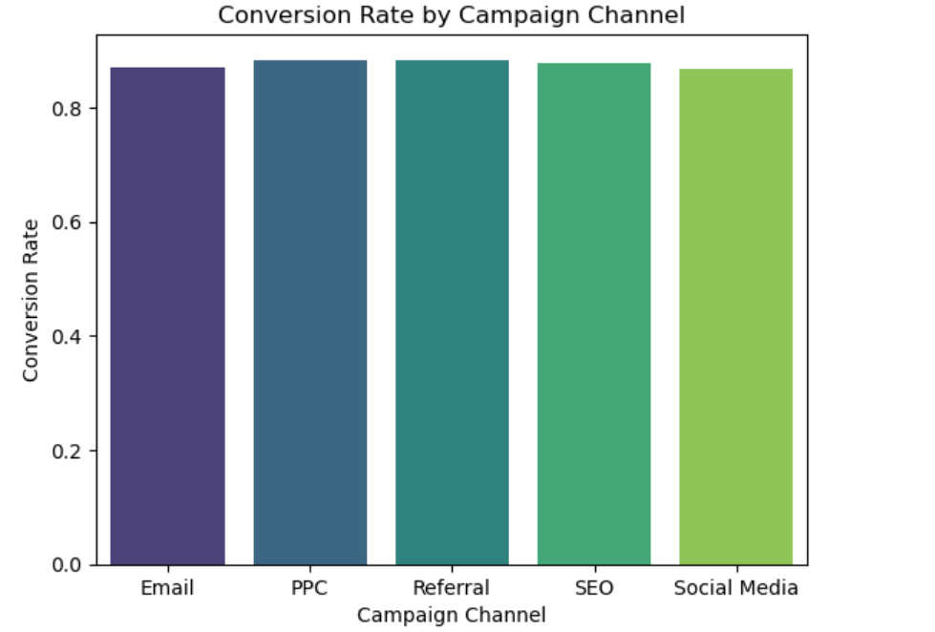
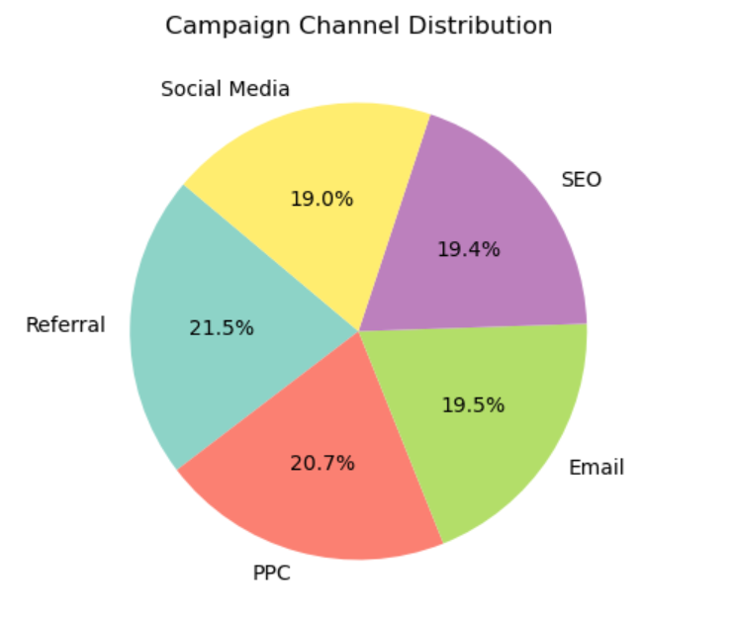
Exploratory data analysis (EDA)

Slide 8
Data Preprocessing
The conversion data shows a significant class imbalance, with less instances of "Not Converted" (0) compared to "Converted" (1).
This imbalance will impact the model's performance, so to prevent the model from becoming biased toward the majority class we have used SMOTE to oversample the minority class.

Slide 9
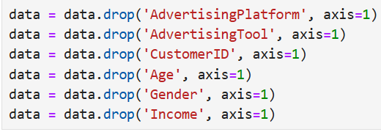

Feature Engineering
In this process we have dropped some features because they have very less significant impact during model training.
In this next process we convert categorical data into numerical data using Label Encoding.
In this case those two columns were CampaignChannel and CampaignType.

Slide 10
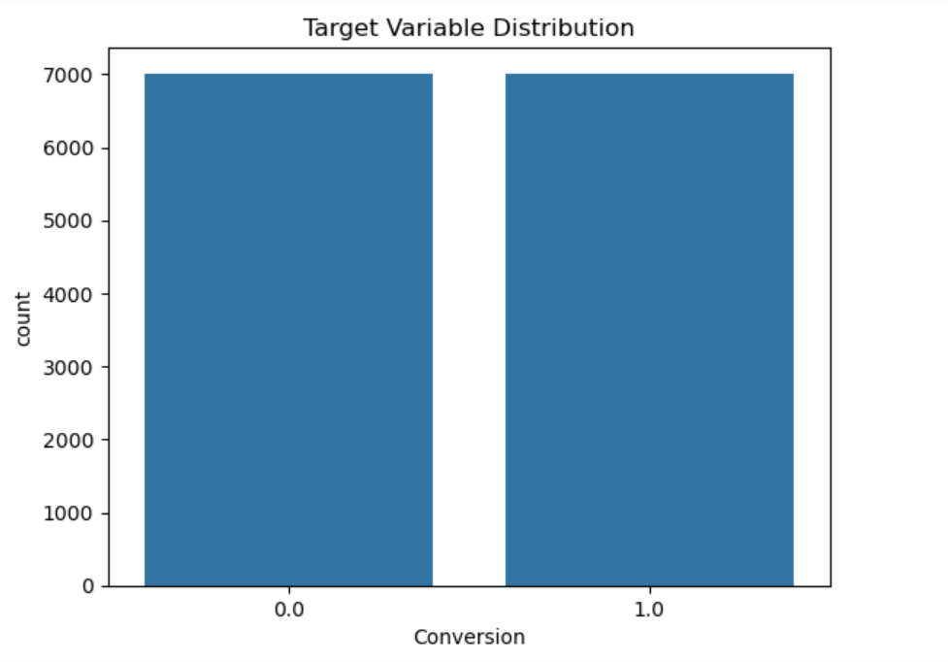
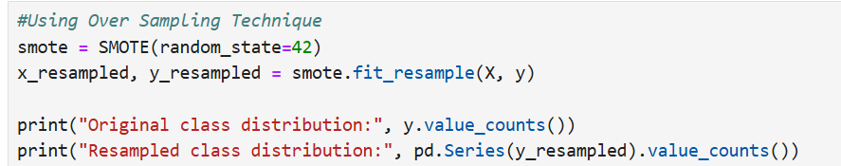
Model Selection
We have used SMOTE to oversample the minority class since we have a skewed dataset.
SMOTE creates a balanced dataset by artificially oversampling the minority class to match the dominant class.

Slide 11
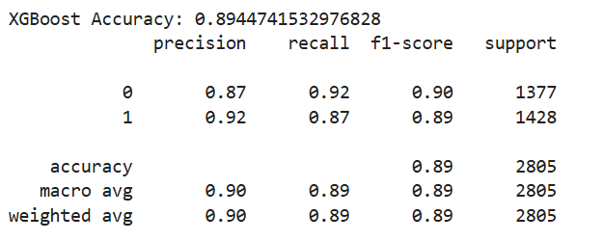
Model Selection
In this process we try different algorithms since it a classification problem we have used Logistic Regression, Decision Tree, Random Forest, Gradient Boosting, XG Boost, SVM, KNN.
After applying all the algorithms and finding their F1 score, along with confusion matrix and Precision Recall Curve we get the best F1 score using XG Boost.

Slide 12
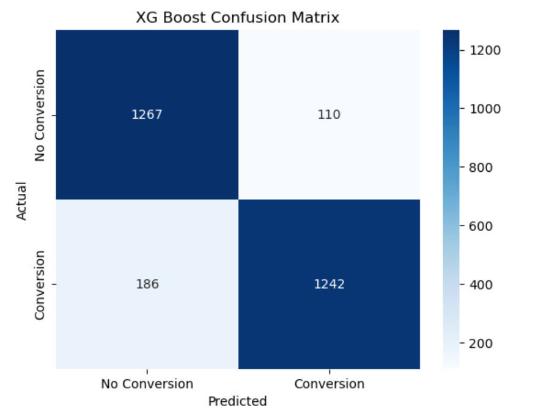
Model Evaluation
In this process, we generate a heatmap to visualize the relationship between predicted and actual values using Confusion Matrix.
Since False Negatives represent the most critical prediction error in this case, we have selected a model that minimizes False Negatives compared to all other algorithms we tested.

Slide 13
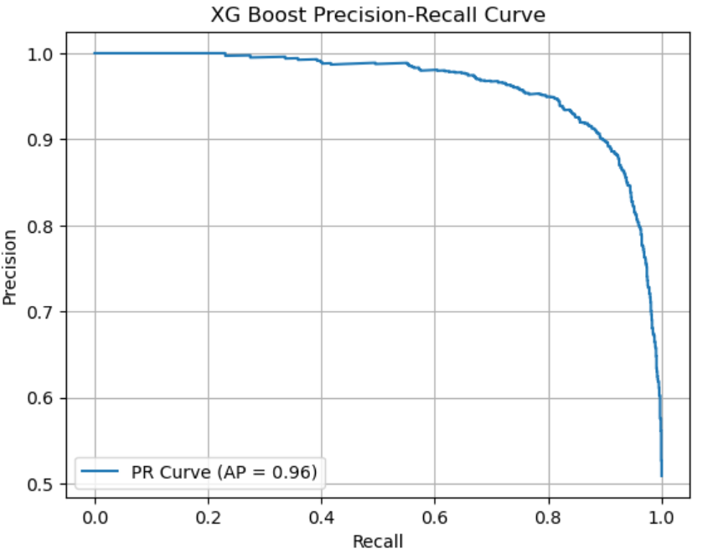
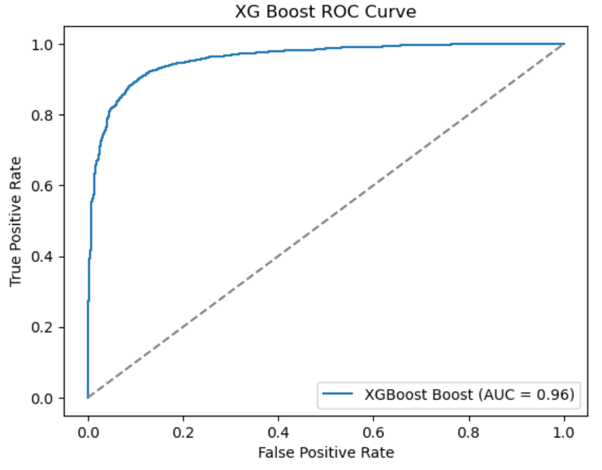
Model Evaluation
As we proceed further we plot graphs like Precision-Recall Curve and ROC Curve to assess the performance of a classification model.

Slide 14
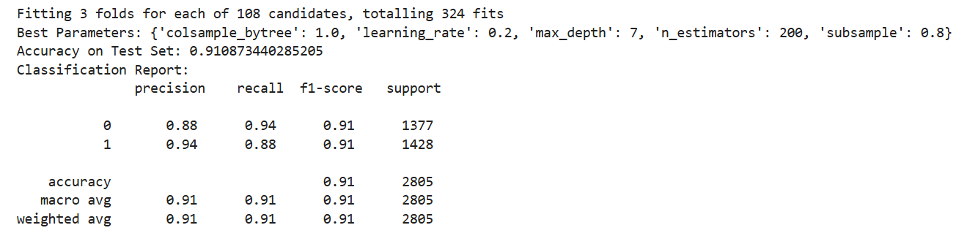
Model Evaluation
After getting an Accuracy and F1 Score of 89% we made the decision to apply Hyperparameters.
We utilized GridSearchCV and RandomizedSearchCV and we got the accuracy and F1 Score of 91%.

Slide 15
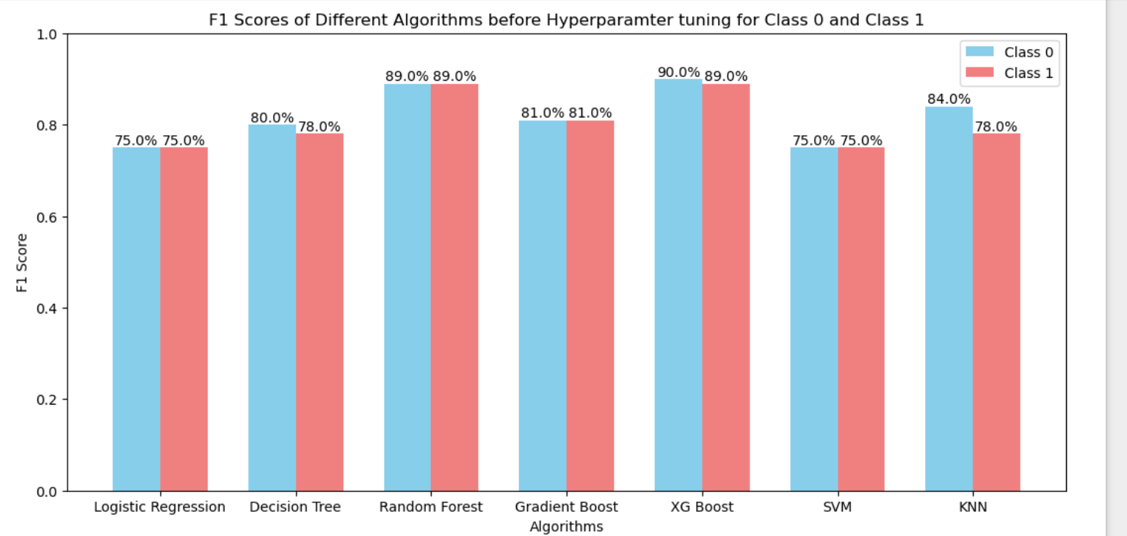
Model Evaluation

Slide 16
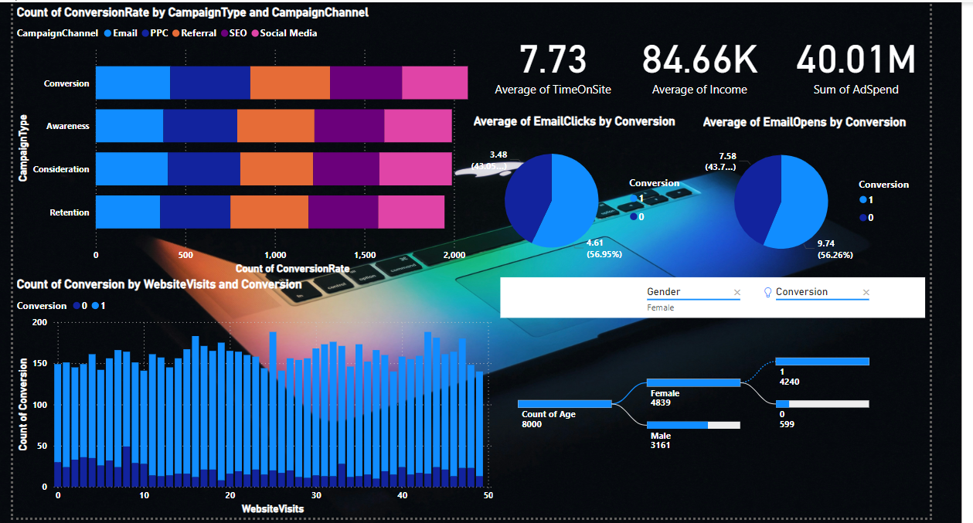
PowerBI Report

Slide 17
Questions ?

Slide 18
Thank You!

